Slide 1
Multiway Search Trees

Slide 2
Outline
In this topic we will look at:
An introduction to multiway search trees
An implementation in C++
In-order traversals of multiway trees

Slide 3
Binary Tree
Full Binary Tree
Complete Binary Tree
Perfect Binary Tree
https://www.geeksforgeeks.org/binary-tree-set-3-types-of-binary-tree/

Slide 4
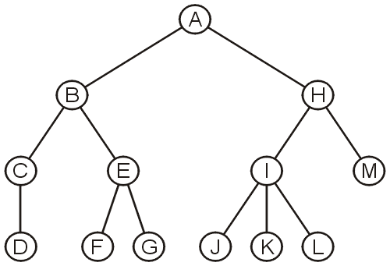
In-order traversals on general trees
6.4.1
We have noted that in-order traversals only make sense for binary search trees and not N-ary trees in general

Slide 5
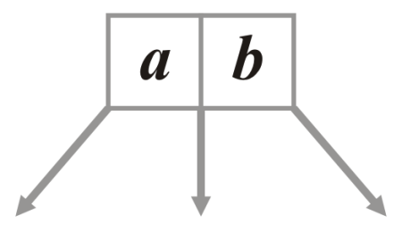
3-Way Trees
6.4.2
Suppose we had a node storing two values and with three sub-trees:

Slide 6
3-Way Trees
6.4.2
This could be implemented as follows:
template <typename Type>
class Three_way_node {
Three_way_node *p_left_tree;
Type first_value;
Three_way_node *p_middle_tree;
Type second_value;
Three_way_node *p_right_tree;
// ...
};
left_element
right_element
p_left_tree
p_middle_tree
p_right_tree

Slide 7
3-Way Trees
6.4.2
In order to define a search tree, we will require that:
The first element is less than the second element
All sub-trees are 3-way trees
The left sub-tree contains items less than the 1st element
The middle sub-tree contains items between the two elements
The right sub-tree contains items greater than the 2nd element
left_element
right_element
p_left_tree
p_middle_tree
p_right_tree

Slide 8
3-Way Trees
6.4.2
If a node has only one element, all trees are assumed to be empty
If a second object is inserted, it will be inserted into this node
template <typename Type>
class Three_way_node {
Three_way_node *p_left_tree;
Type first_value;
Three_way_node *p_middle_tree;
Type second_value;
Three_way_node *p_right_tree;
int num_values; # 1 or 2
// ...
};
template <typename Type>
bool Three_way_node::full() const {
return num_values == 2;
}

Slide 9
3-Way Trees
6.4.2.1
Most operations are more complex than with binary trees…
template <typename Type>
Three_way_node *Three_way_node<Type>::find( Type const &obj ) const {
if ( !full() ) {
return ( first() == obj );
}
if ( (obj == first()) || (obj == second()) ) {
return this;
} else if ( obj < first() ) {
return ( left() == nullptr) ? nulltpr : left()->find( obj );
} else if ( obj > second()) ) {
return ( right() == nullptr) ? nullptr : right()->find( obj );
} else {
return (middle() == nulltpr) ? nullptr : middle()->find( obj );
}
}

Slide 10
3-Way Trees
6.4.2.1
Insertion also becomes much more interesting
template <typename Type>
bool Three_way_node<Type>::insert( Type const &obj ) {
if ( !full() ) {
if ( obj == first() ) {
return false;
} else if ( obj < first() ) {
second_value = first();
first_value = obj;
} else {
second_value = obj;
}
num_values = 2;
return true;
}

Slide 11
3-Way Trees
6.4.2.1
if ( obj == first() || obj == second() ) {
return false;
}
if ( obj < first() ) {
if ( left() == nullptr ) {
p_left_tree = new Three_way_node( obj );
return true;
} else {
return left()->insert( obj );
}
} else if ( obj > second() ) {
// create or insert a new node at the right sub-tree
} else {
// create or insert a new node at the middle sub-tree
}
}
Erasing an element is even more complex
There are many more cases to consider

Slide 12
Insertion into 3-Way Trees
6.4.2.2
Consider inserting values into an empty 3-way tree:
Starting with 68, it would be inserted into the root

Slide 13

Insertion into 3-Way Trees
6.4.2.2
If 27 was inserted next, it would be fit into the root node

Slide 14

Insertion into 3-Way Trees
6.4.2.2
If 27 was inserted next, it would be fit into the root node

Slide 15
Insertion into 3-Way Trees
6.4.2.2
Any new insertion would create an appropriate sub-tree
Inserting 91, we note that 91 > 68, so a right sub-tree is constructed

Slide 16
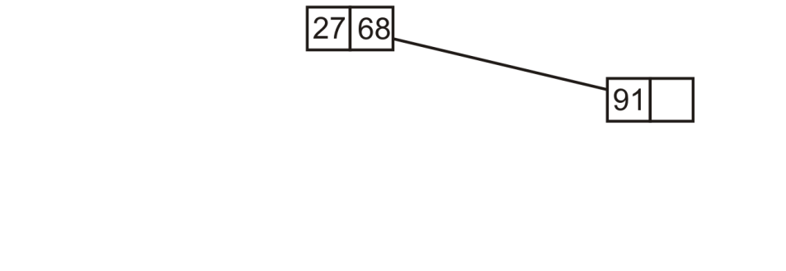
Insertion into 3-Way Trees
6.4.2.2
Any new insertion would create an appropriate sub-tree
Inserting 91, we note that 91 > 68, so a right sub-tree is constructed

Slide 17
Insertion into 3-Way Trees
6.4.2.2
If we insert 38, we note that 28 < 38 < 68 and thus build a new sub-tree in the middle

Slide 18
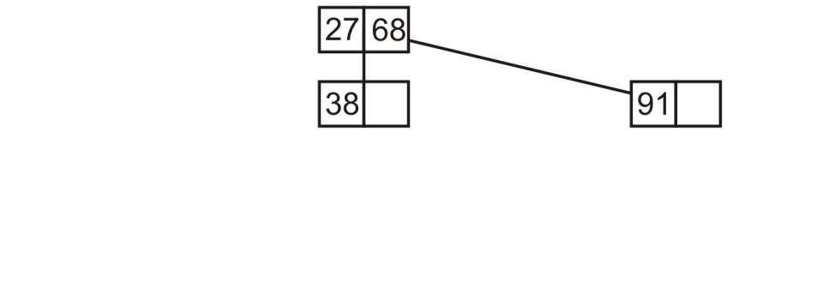
Insertion into 3-Way Trees
6.4.2.2
If we insert 38, we note that 28 < 38 < 68 and thus build a new sub-tree in the middle

Slide 19
Insertion into 3-Way Trees
6.4.2.2
At this point, if we insert 82, we note 82 > 68 and the right sub-tree is not yet full

Slide 20
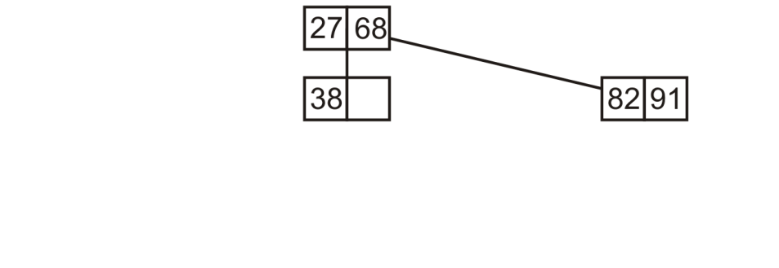
Insertion into 3-Way Trees
6.4.2.2
At this point, if we insert 82, we note 82 > 68 and the right sub-tree is not yet full

Slide 21
Insertion into 3-Way Trees
6.4.2.2
If we insert 14, we note 14 < 27, so we create a new node

Slide 22
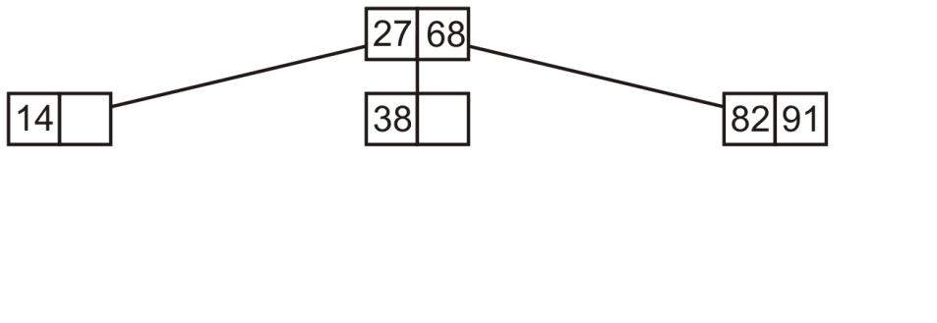
Insertion into 3-Way Trees
6.4.2.2
If we insert 14, we note 14 < 27, so we create a new node

Slide 23
Insertion into 3-Way Trees
6.4.2.2
Next, inserting 62, 27 < 62 < 28 so we insert it into the middle sub-tree which also is not full

Slide 24
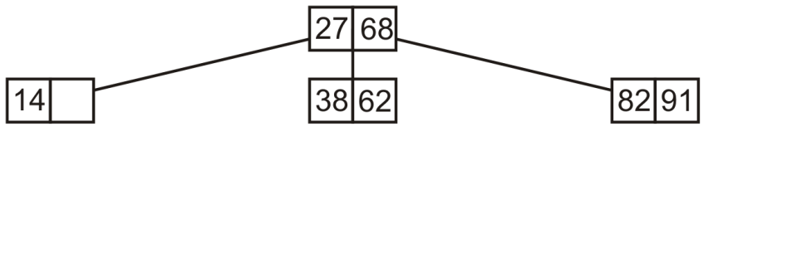
Insertion into 3-Way Trees
6.4.2.2
Next, inserting 62, 27 < 62 < 28 so we insert it into the middle sub-tree which also is not full

Slide 25
Insertion into 3-Way Trees
6.4.2.2
If we insert 45,
First, 27 < 45 < 68 and then 38 < 45 < 62

Slide 26
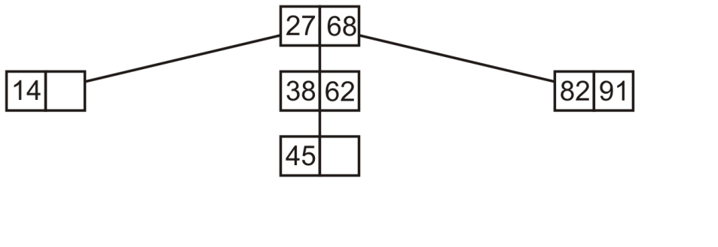
Insertion into 3-Way Trees
6.4.2.2
If we insert 45,
First, 27 < 45 < 68 and then 38 < 45 < 62

Slide 27
Insertion into 3-Way Trees
6.4.2.2
If we insert 76, we note 68 > 76 but then 76 < 82
Create a new left sub-tree of the 82-91 node

Slide 28
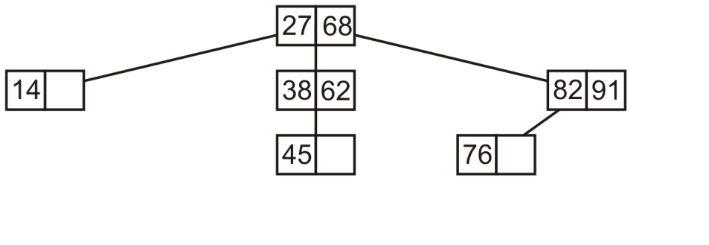
Insertion into 3-Way Trees
6.4.2.2
If we insert 76, we note 68 > 76 but then 76 < 82
Create a new left sub-tree of the 82-91 node

Slide 29
Insertion into 3-Way Trees
6.4.2.2
If we insert 4, 4 < 27 and the left sub-tree contains only a single element

Slide 30
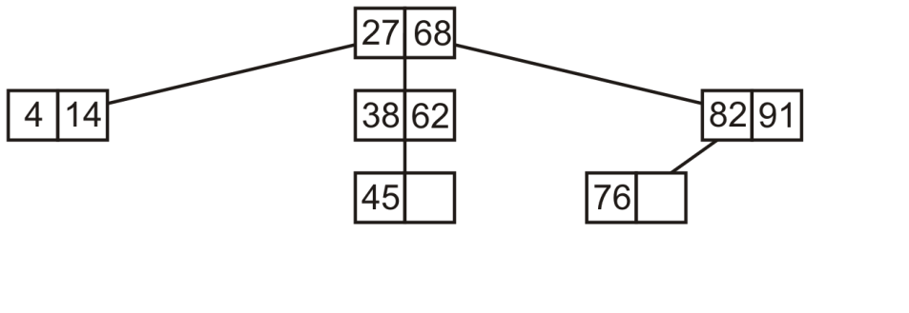
Insertion into 3-Way Trees
6.4.2.2
If we insert 4, 4 < 27 and the left sub-tree contains only a single element

Slide 31
Insertion into 3-Way Trees
6.4.2.2
If we insert 51, 27 < 51 < 68 and 38 < 51 < 62; therefore, we insert 51 into the node containing 45

Slide 32
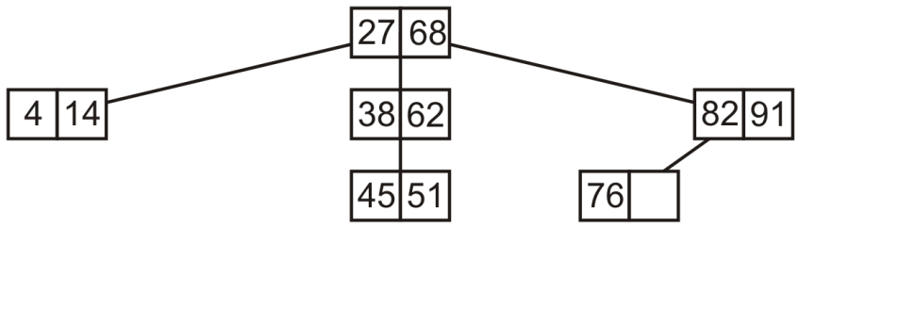
Insertion into 3-Way Trees
6.4.2.2
If we insert 51, 27 < 51 < 68 and 38 < 51 < 62; therefore, we insert 51 into the node containing 45

Slide 33
Insertion into 3-Way Trees
6.4.2.2
If we insert 8, 8 < 27 and then 4 < 8 < 14
Construct a new middle sub-tree of the 4-14 node

Slide 34
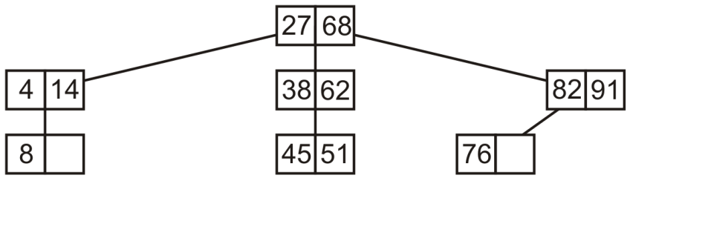
Insertion into 3-Way Trees
6.4.2.2
If we insert 8, 8 < 27 and then 4 < 8 < 14
Construct a new middle sub-tree of the 4-14 node

Slide 35
Insertion into 3-Way Trees
6.4.2.2
If we insert 98, 98 > 68 and 98 > 91
Construct a new right sub-tree of the 81-91 node

Slide 36
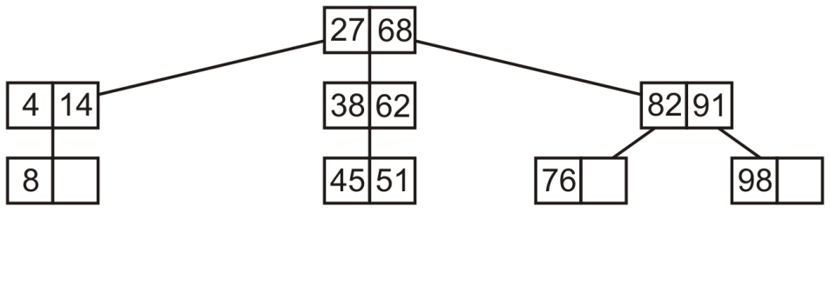
Insertion into 3-Way Trees
6.4.2.2
If we insert 98, 98 > 68 and 98 > 91
Construct a new right sub-tree of the 81-91 node

Slide 37
Insertion into 3-Way Trees
6.4.2.2
Finally, consider adding 57:
27 < 57 < 68, 38 < 57 < 62 and 57 > 51
Construct a new right sub-tree of the 45-51 node

Slide 38
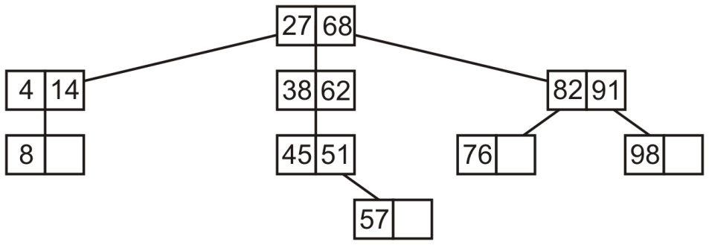
Insertion into 3-Way Trees
6.4.2.2
Finally, consider adding 57:
27 < 57 < 68, 38 < 57 < 62 and 57 > 51
Construct a new right sub-tree of the 45-51 node

Slide 39
In-order Traversals
6.4.2.1
Insertion also becomes much more interesting
template <typename Type>
void Three_way_node<Type>::in_order_traversal() const {
if ( !full() ) {
cout << first();
} else {
if ( left() != nullptr ) {
left()->in_order_traversal();
}
cout << first();
if ( middle() != nullptr ) {
middle()->in_order_traversal();
}
cout << second();
if ( right() != nullptr ) {
right()->in_order_traversal();
}
}
}

Slide 40
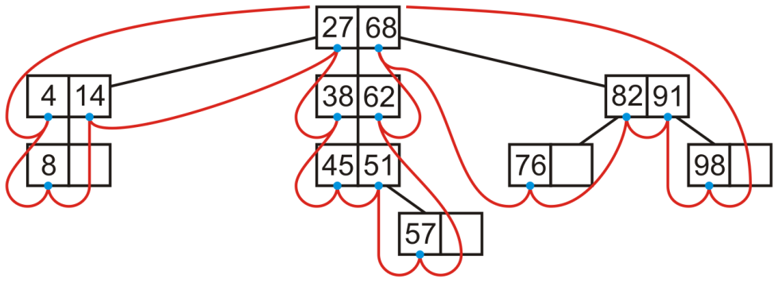
In-order Traversals
6.4.2.3
An in-order traversal can be performed on this tree:
4 8 14 27 38 45 51 57 62 68 76 82 91 98

Slide 41
Multiway tree implementation
6.4.3
Suppose we had a node storing N – 1 values and with N sub-trees
We will describe this as an N-way tree
template <typename Type, int N>
class Multiway_node {
private:
int num_values;
Type elements[N – 1];
Multiway_node *[N]; // an array of pointers to multiway nodes
public:
Multiway_node( Type const & );
// ...
};
template<typename Type, int M>
bool M_ way_node<Type, M>::full() const {
return ( num_values == M - 1 );
}

Slide 42
Multiway tree implementation
6.4.3
The constructor would initial the node to store one element
template <typename Type, int N>
Multiway_node<Type, N>::Multiway_node( Type const &obj ):
num_values( 1 ) {
elements[0] = obj;
// All sub-treees are null sub-trees
for ( int i = 0; i < N; ++i ) {
subtrees[i] = nullptr;
}
}

Slide 43
Multiway tree implementation
6.4.3
An in-order traversal would be similar:
template <typename Type, int N>
void Multiway_node<Type, N>::in_order_traversal() const {
if ( empty() ) {
return;
} else if ( !full() ) {
for ( int i = 0; i < num_values; ++i ) {
cout << elements[i];
}
} else {
for ( int i = 0; i < N - 1; ++i ) {
if ( subtrees[i] != nullptr ) {
subtrees[i]->in_order_traversal();
}
cout << elements[i];
}
subtrees[N - 1]->in_order_traversal();
}
}

Slide 44
Size
6.4.3.1
Question:
What is the maximum number of elements which may be stored in a multiway tree of height h?
We will consider 3-way trees and, if possible, generalize

Slide 45
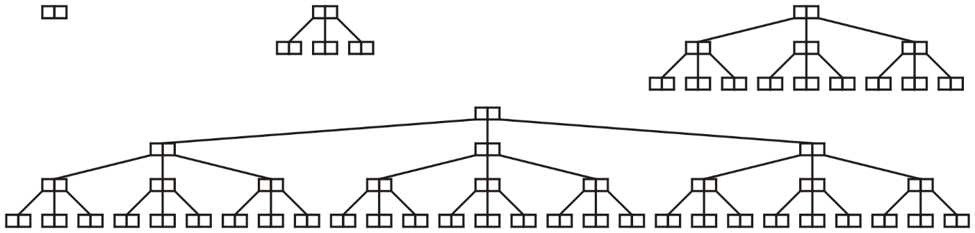
Size
6.4.3.1
Examining these perfect 3-way trees
we get the table:
h | Size | Formula
0 | 2 | 3¹ – 1
1 | 8 | 3² – 1
2 | 26 | 3³ – 1
3 | 80 | 3⁴ – 1

Slide 46
Size
6.4.3.1
Suggested form:
The maximum number of nodes in a perfect multiway tree of height h is N^{h + 1} – 1
Observations
This is true when N = 2: 2^{h + 1} – 1
To prove this, we need only observe:
A perfect N-ary tree of height h has nodes
Thus, if each node now has N – 1 elements:

Slide 47
Size
6.4.3.2
Note also that the majority of elements are in the leaf nodes:
There are N^{h} leaf nodes in a perfect M-way search tree of height h
Each of these stores N – 1 elements
Thus, we may calculate the ratio
For example:
In an 8-way search tree, ~87.5 % of elements are in leaf nodes
In a 100-way search tree, ~99 % of elements are in the leaf nodes

Slide 48
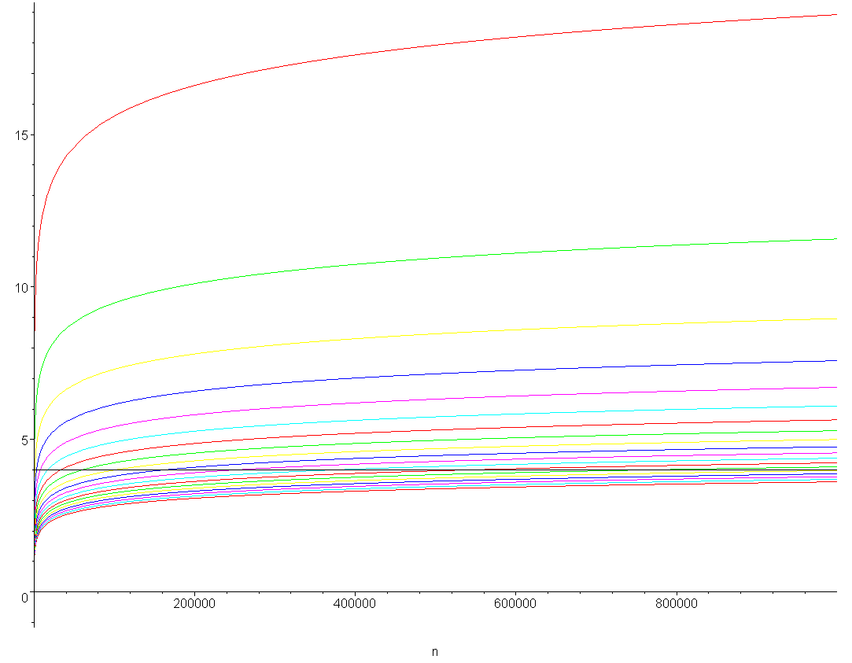
Minimum height
6.4.3.3
The minimum height of a multiway tree storing n elements is ⌊log_{N}(n)⌋
For large N, the depth is potentially much less than a binary tree
A plot of the minimum height of a multiway tree for N = 2, 3, ..., 20 for up to one-million elements

Slide 49
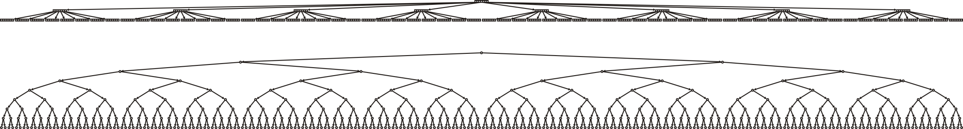
8-way trees versus binary trees
6.4.3.3
Compare:
A perfect 8-way tree with h = 2
511 elements in 73 nodes
A perfect binary tree with h = 8
511 elements in 511 nodes

Slide 50
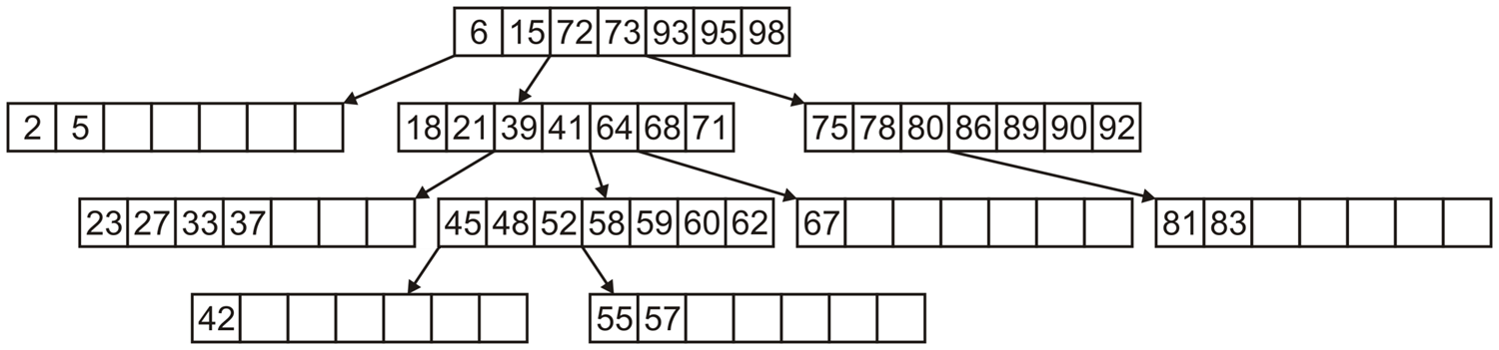
8-way tree example
6.4.3.4
A sample 8-way search tree:
Note how a binary search is required to find the appropriate sub-tree
How do you determine if 43 is in this search tree?
Question: what order would these entries have been inserted?
How do we erase an element?

Slide 51
Multiway trees
6.4.3.4
Advantage:
Shorter paths from the root
Disadvantage:
More complex
Under what conditions is the additional complexity worth the effort?
When the cost from jumping nodes is exceptionally dominant

Slide 52
Summary
In this topic, we have looked at:
Multiway trees
Each node stores N – 1 sorted elements
N sub-trees interleave the elements
Perfect Multiway trees store N^{h +1} – 1 elements
We saw an implementation in C++
We considered in-order traversals of multiway trees
Has the potential to store more elements in shallower trees

Slide 53
References
[1] Cormen, Leiserson, and Rivest, Introduction to Algorithms, MIT Press, 1990, §7.1-3, p.152.
[2] Weiss, Data Structures and Algorithm Analysis in C++, 3rd Ed., Addison Wesley, §6.5-6, p.215-25.

Slide 54
Usage Notes
These slides are made publicly available on the web for anyone to use
If you choose to use them, or a part thereof, for a course at another institution, I ask only three things:
that you inform me that you are using the slides,
that you acknowledge my work, and
that you alert me of any mistakes which I made or changes which you make, and allow me the option of incorporating such changes (with an acknowledgment) in my set of slides
Sincerely,
Douglas Wilhelm Harder, MMath
dwharder@alumni.uwaterloo.ca

